Slide 1
Predicting Movie Collection Using -Decision Tree Regression
~ Suhas D S

Slide 2
Machine Learning Life Cycle:
Problem Understanding
Data Collection.
Data Preparation.
Choose a Model.
Train the Model
Evaluate the Model
Parameter Tuning
Make Predictions

Slide 3
Problem Statement
Determine the Movie collection dataset and developing a Decision tree regression model to predict the movie collections

Slide 4
Features of the Dataset
Rows:
* We have 506 rows in our dataset
Features:
* We have 18 columns in that
- 16 numerical features
- 2 categorical features
Target Variable: Collection
Problem Type- Regression type

Slide 5
Data Cleaning and Pre-processing

Slide 6
Missing value Treatment
In the given data we have 12 missing values in Time_taken feature
Since there are outliers in time_taken column we should replace null with median

Slide 7
Changing data types
There were 2categorical features in dataset
By using pd.get_dummies()
I converted all my categorical features into numerical features

Slide 8
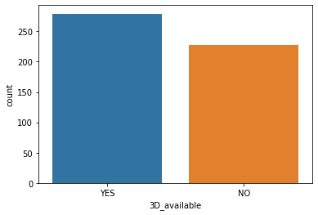
Exploratory Data Analysis
From this we can understand that the availability of 3D movies are more compared to non 3D

Slide 9
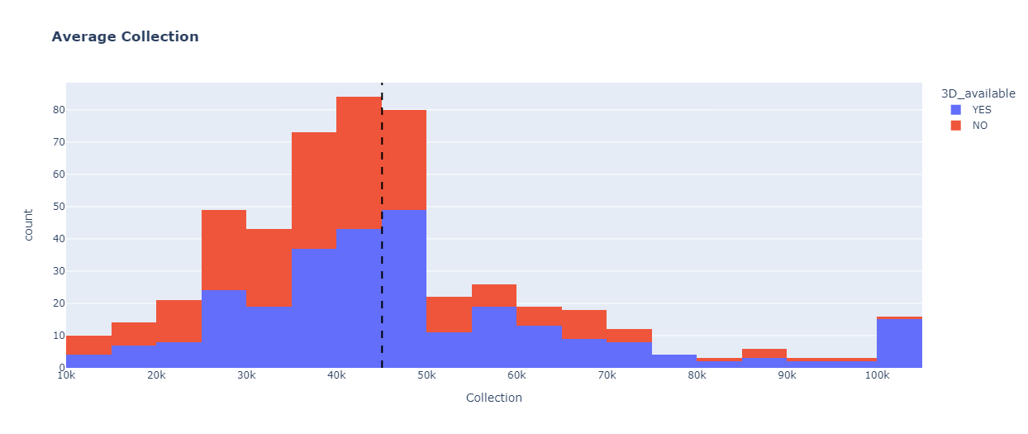
Average Collection
For collections more than 50k majority of the collection came for 3D movies

Slide 10
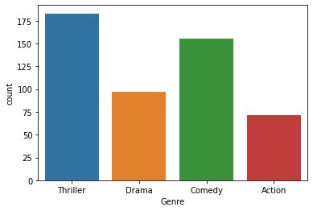
Genre
Here we can visualize that number of movies from thriller and comedy are more

Slide 11
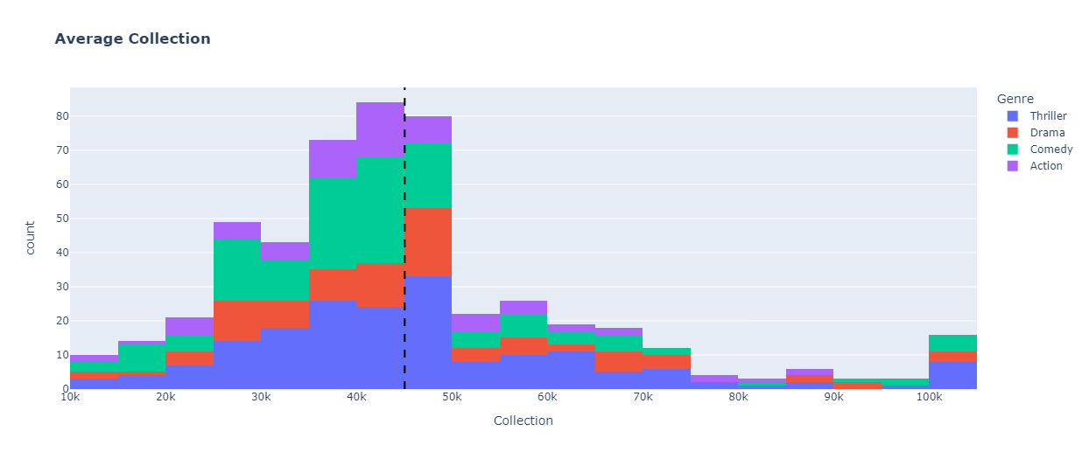
Average Collection
Here we can visualize Average Collections with respect to Different Genre

Slide 12
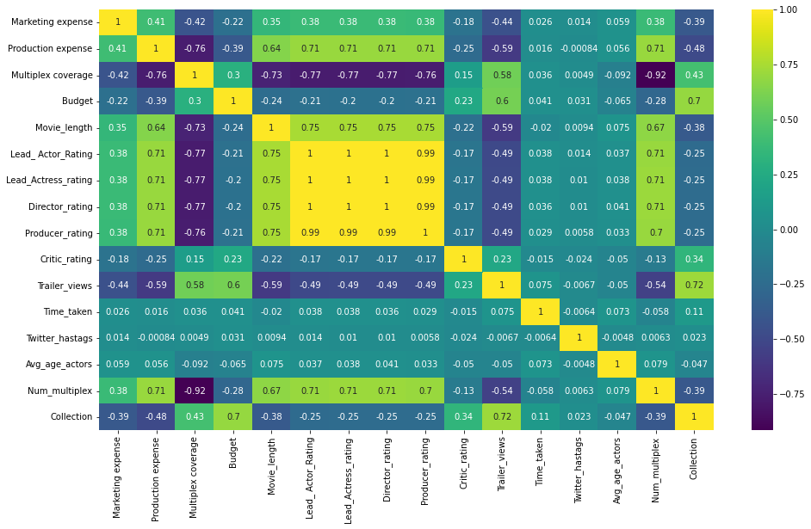
Correlation

Slide 13
Models and Approaches

Slide 14
Standardization
I used StandardScaler for Standardization
By using this it makes mean =0 and scales the data to unit variance

Slide 15
Models Used
Predictive Model used is Decision Tress Regression.
We got good metric values
(MSE 80750526.31578948) and 76.5% score without hyperparameter tuning model
R2 value is 76.5%

Slide 16
Hyper parameter tuning.
Here I used GridSearchCV to find best parameters for our Decision tree regression model.
After tuning the model I got
MSE: 125674495.13882908 and 63.5% score

Slide 17
Comparision
Without Hyper parameter tuning
-MAE (6409.210)
-MSE (81275526.31)
-RMSE (9015.29)
- R2 value = 76.5% strong
With Hyper parameter tuning
-MAE (8037.38)
-MSE (125674495.138)
-RMSE (11210.463)
- R2 value = 63.5% strong

Slide 18
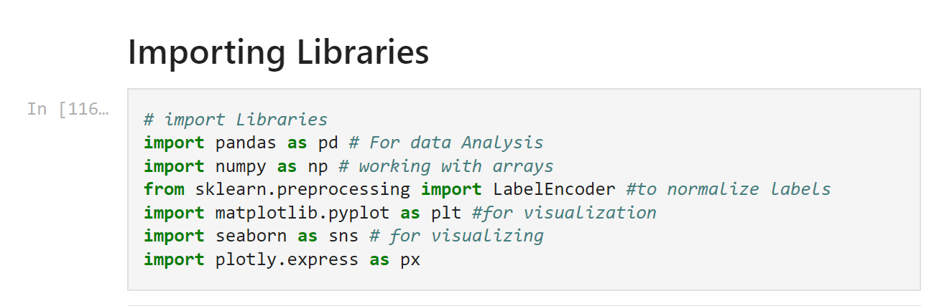
Coding Part:
Importing the required Libraries
Pandas- for data manipulation
Numpy - working with arrays
LabelEncoder – to normalize the lables
matplotlib – for visualization
Seaborn - for visualization
Plotly – for visualization

Slide 19
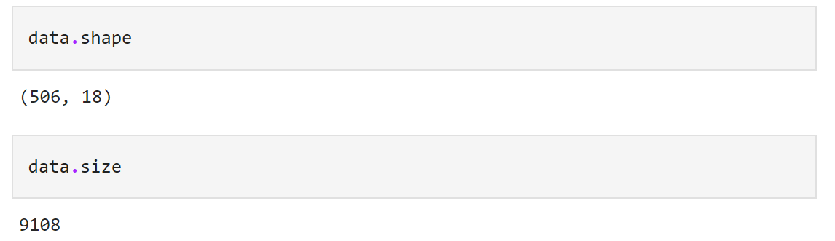
Data.shape – (used to check the no.of rows and columns in our dataset)
Data.size- (used to check the size of dataset)

Slide 20
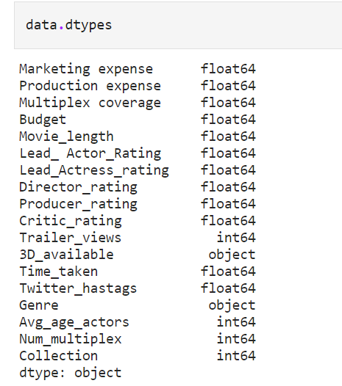
Data.dtype-
It is used to show the datatypes in our dataset

Slide 21
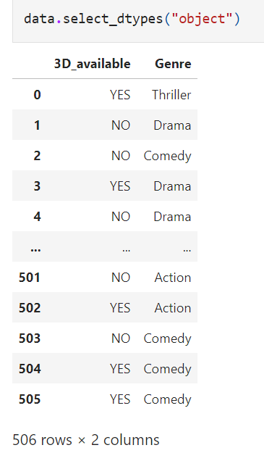
This is the code used to check the
Categorical features present in our datset

Slide 22
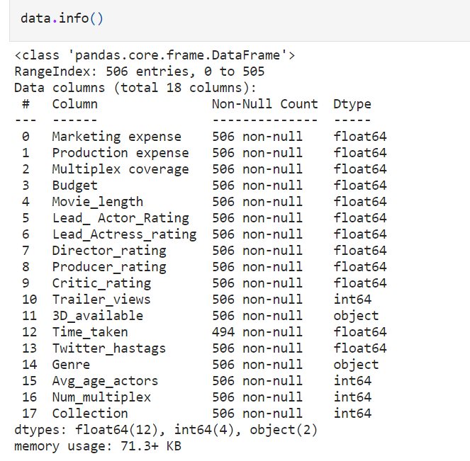
It shows the information of each features in our datset

Slide 23
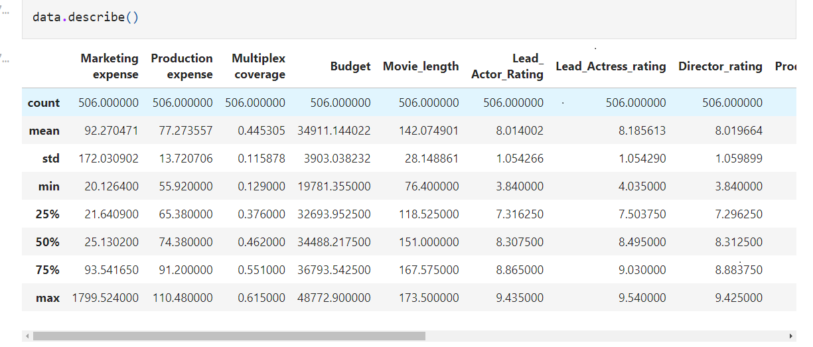
Describe() displays summary statistics for dataframe

Slide 24
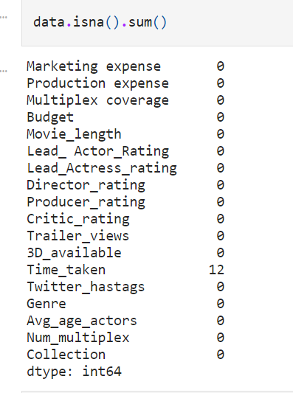
Data.isna().sum()
It is used to check the null values in our dataset

Slide 25
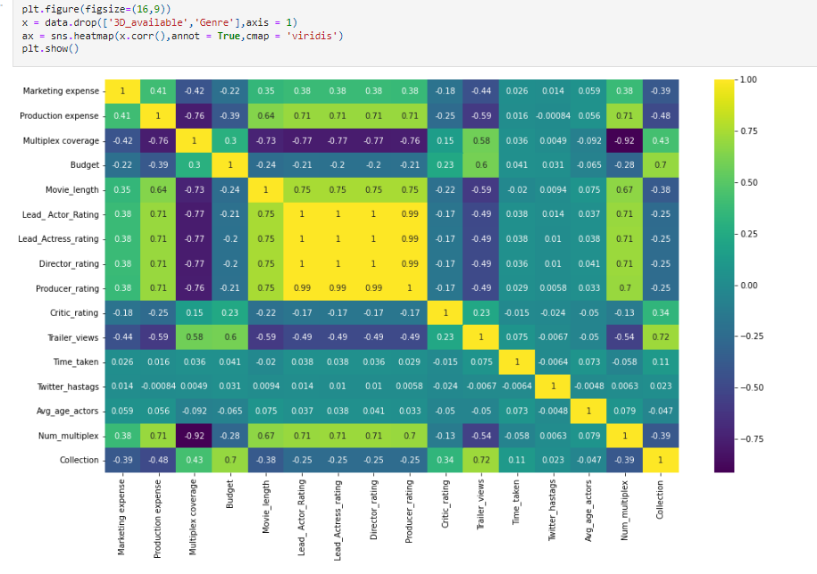

Slide 26
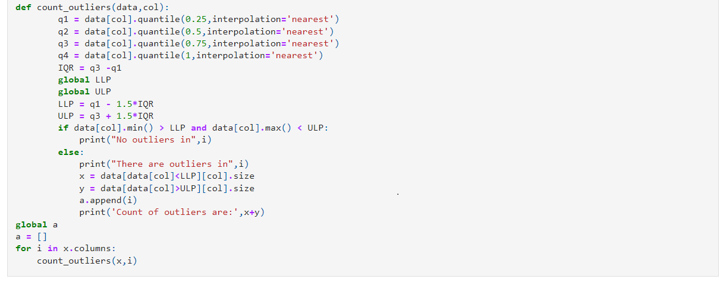
By using this code we can find how many outliers present in our dataset

Slide 27
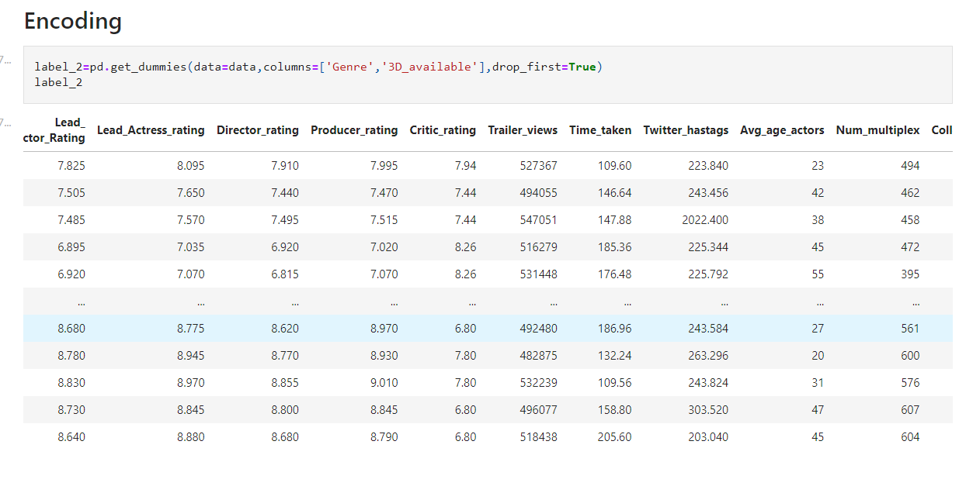
Here I converted categorical columns into numerical columns

Slide 28
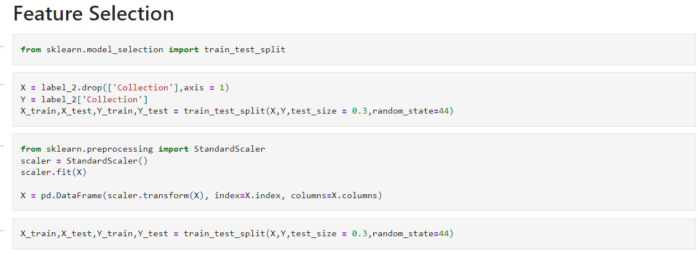
Here I differentiated the target column and used StandardScalar for Standardization
And split the dataFrame into train and test data

Slide 29
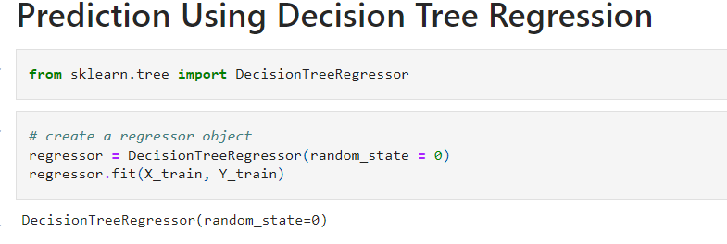

Here I used Decision tree Regression for prediction

Slide 30
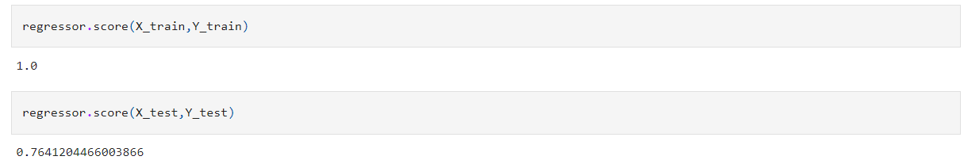
We got 100% score on training data.
On test data we got 76.5% score because we did not provide any tuning parameters while initializing the trees as a result of which algorithm splits
The training data till the leaf node. Due to which depth of the tree increased and model did the overfitting.
That’s why we are getting high score on our training data and less score on test data.
So to solve this problem we would use hyper parameter tuning.
We can use GridSearch or Randomized Search for hyper parameters tuning

Slide 31
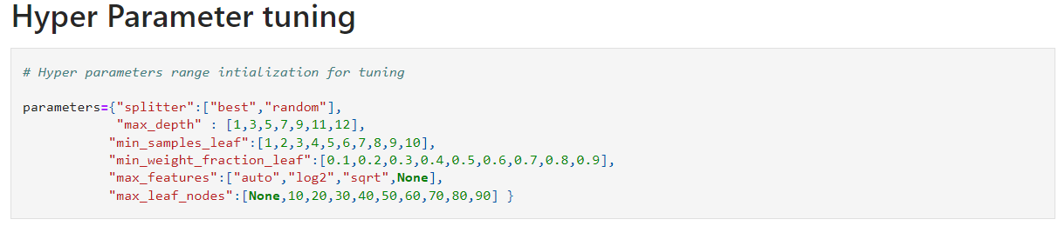
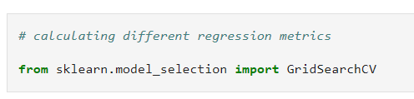
Above we initialize hyper parameters random range using Gridsearch to find the best parameters for our decision tree model

Slide 32
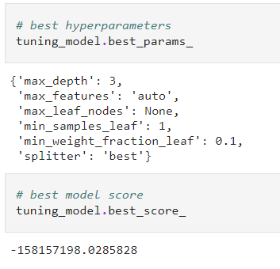
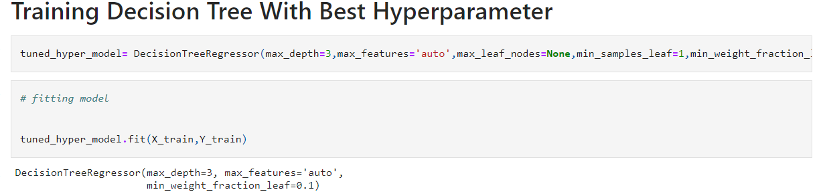
Hyper parameter tuning took around 13 min . It might vary depending upon your machine

Slide 33
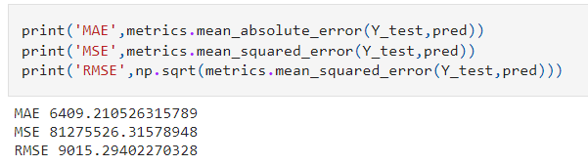
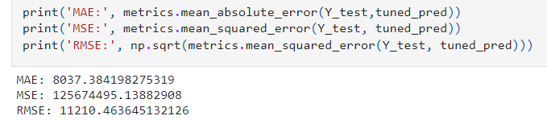
Without Hyper parameter tuning
With Hyper parameter tuning

Slide 34
Conclusion
If you observe the above metrics for both the models, We got good metric values(MSE 80750526.31578948) and 76.5% score without hyper parameter tuning model compare to model hyper parameter tuning.

